Slide 1
Density-based spatial clustering of applications with noise (DBSCAN)
The DBSCAN algorithm is based on this intuitive notion of “clusters” and “noise”. The key idea is that for each point of a cluster, the neighborhood of a given radius has to contain at least a minimum number of points.
Why do we need DBSCAN Clustering?
Clustering is an unsupervised learning technique where we try to group the data points based on specific characteristics. There are various clustering algorithms with K-Means and Hierarchical being the most used ones.
Some of the use cases of clustering algorithms include:
Document Clustering
Recommendation Engine
Image Segmentation
Market Segmentation
Search Result Grouping
and Anomaly Detection.

Slide 2
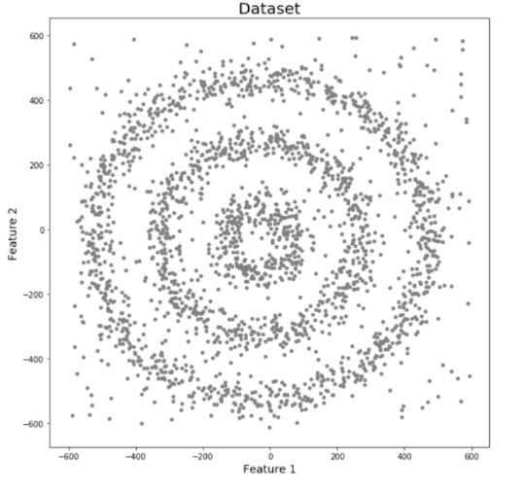
K-Means and Hierarchical Clustering both fail in creating clusters of arbitrary shapes. They are not able to form clusters based on varying densities. That’s why we need DBSCAN clustering.
Let’s try to understand it with an example. Here we have data points densely present in the form of concentric circles:
We can see three different dense clusters in the form of concentric circles with some noise here. Now, let’s run K-Means and Hierarchical clustering algorithms and see how they cluster these data points.

Slide 3
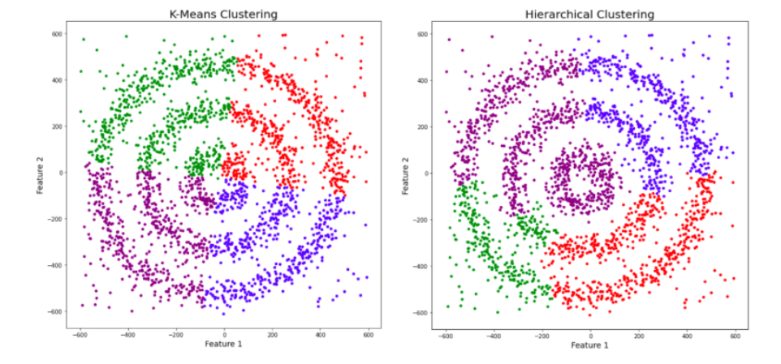
You might be wondering why there are four colors in the graph? As I said earlier, this data contains noise too, therefore, I have taken noise as a different cluster which is represented by the purple color. Sadly, both of them failed to cluster the data points. Also, they were not able to properly detect the noise present in the dataset. Now, let’s take a look at the results from DBSCAN clustering.

Slide 4
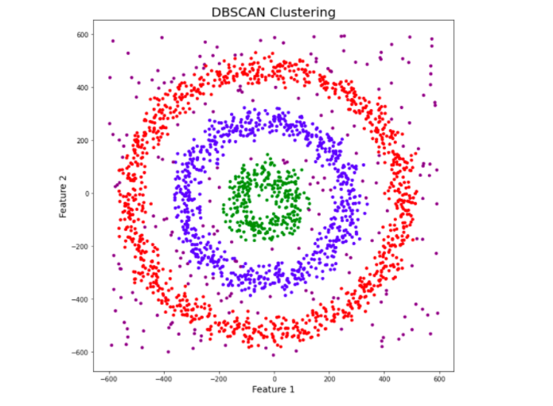
Awesome! DBSCAN is not just able to cluster the data points correctly, but it also perfectly detects noise in the dataset.

Slide 5
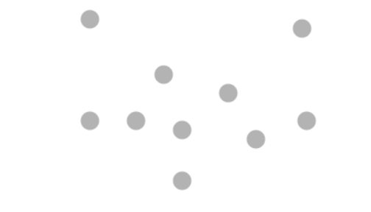
What Exactly is DBSCAN Clustering?
It groups ‘densely grouped’ data points into a single cluster. It can identify clusters in large spatial datasets by looking at the local density of the data points. The most exciting feature of DBSCAN clustering is that it is robust to outliers. It also does not require the number of clusters to be told beforehand, unlike K-Means, where we have to specify the number of centroids.
DBSCAN requires only two parameters: epsilon and minPoints.
Epsilon is the radius of the circle to be created around each data point to check the density.
minPoints is the minimum number of data points required inside that circle for that data point to be classified as a Core point.

Slide 6
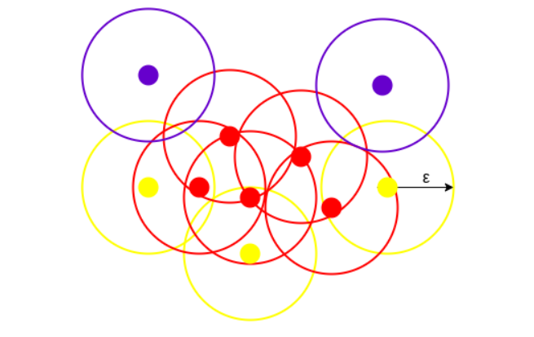
DBSCAN creates a circle of epsilon radius around every data point and classifies them into Core point, Border point, and Noise.
Core — This is a point that has at least minPoints within distance n from itself.
Border — If the number of points is less than minPoints, then it is classified as Border Point,.
Noise — if there are no other data points around any data point within epsilon radius, then it treated as Noise.

Slide 7
All the data points with at least 3 points in the circle including itself are considered as Core points represented by red color.
All the data points with less than 3 but greater than 1 point in the circle including itself are considered as Border points. They are represented by yellow color.
Finally, data points with no point other than itself present inside the circle are considered as Noise represented by the purple color.
Parameter Selection in DBSCAN Clustering
The value of minPoints should be at least one greater than the number of dimensions of the dataset, i.e.,
minPoints>=Dimensions+1.
It does not make sense to take minPoints as 1 because it will result in each point being a separate cluster. Therefore, it must be at least 3. Generally, it is twice the dimensions. But domain knowledge also decides its value.
The value of epsilon can be decided from the K-distance graph. The point of maximum curvature (elbow) in this graph tells us about the value of epsilon. If the value of epsilon chosen is too small then a higher number of clusters will be created, and more data points will be taken as noise. Whereas, if chosen too big then various small clusters will merge into a big cluster, and we will lose details.

Slide 8
Advantages of DBSCAN:
DBSCAN algorithm is robust to outliers (noise points).
DBSCAN is great at separating high density clusters from low density clusters.
Unlike K-means, DBSCAN does not require number of clusters to be specified priorily.
DBSCAN supports non-globular structures as well.
Disadvantages of DBSCAN:
DBSCAN algorithm is not deterministic in the sense that it forms different clusters on different trials. The reason is that the border point that is reachable from more than one core point can join either cluster, depending on the order of processing the data points.
Sometimes, choosing the value of ‘epsilon’ can be difficult especially when the data is in higher dimensions.

